Slide 1
OpenGL Transformations
Advanced Graphics Programming

Slide 2
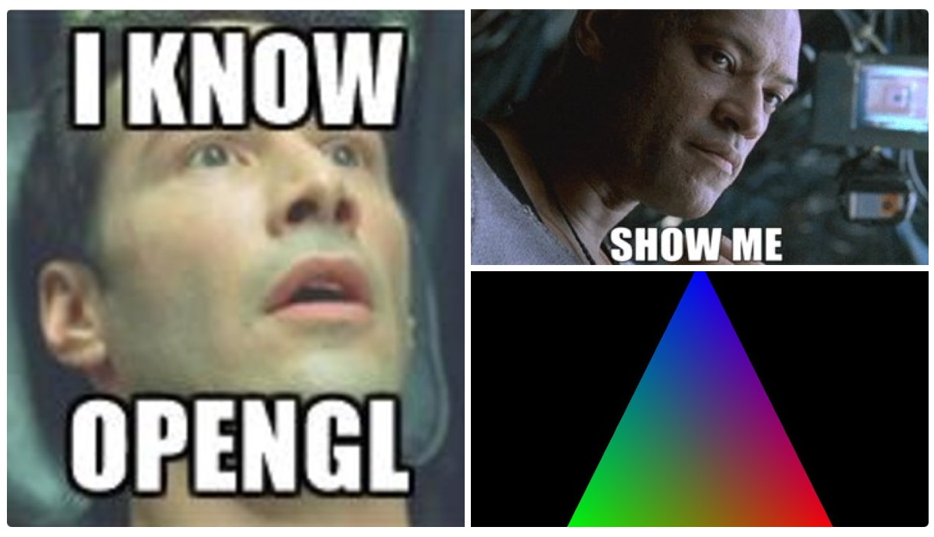
Vertex transformations pipeline

Slide 3
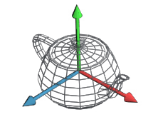

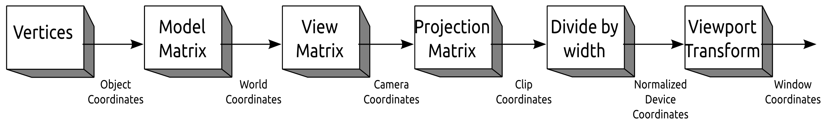
Vertex transformations pipeline
This can happen in vertex shaders
Fixed pipeline (always)
Model-view-projection transforms are done within the vertex shader IF WE WANT.
Applying vertex transformations in our vertex shader is completely optional and up to us.
Divide by width (also called perspective divide), and viewport transforms are part of the fixed graphics pipeline and they are always executed.
We configure the viewport transform with: glViewport(x, y, width, height)

Slide 4
Vertex transformations pipeline
The local coordinates of an object (or object coordinates) are its coordinates as read from the file generated with the 3D modeling software.

Slide 5
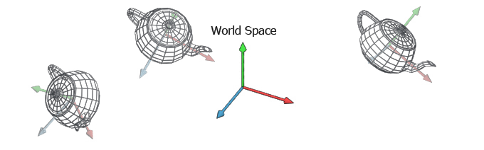
Vertex transformations pipeline
The world coordinates, are the coordinates of an object with respect to the world space.
We use the world matrix (or model matrix) to transform from local coordinates to world coordinates.

Slide 6
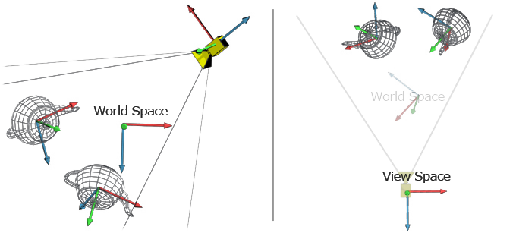
Vertex transformations pipeline
The camera coordinates, are the coordinates of an object with respect to the camera space (also eye coordinates, or view coordinates).
We use the view matrix (or camera / eye matrix) to transform from world coordinates to camera/eye/view coordinates.

Slide 7
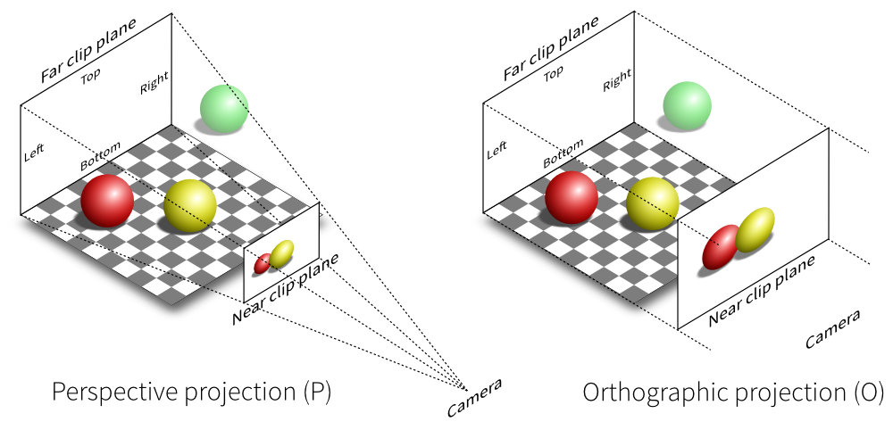
Vertex transformations pipeline
The NDC coordinates, are the coordinates of an object after projection and perspective division.
We use the projection matrix to transform from view coordinates to clip coordinates.
We then perform the perspective division (x/w, y/w, z/w) to obtain the NDCs.
Perspective projection

Slide 8
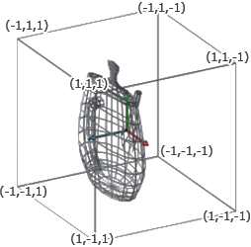
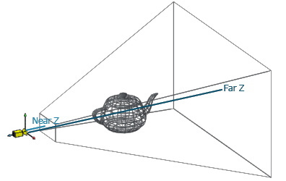
Vertex transformations pipeline
The NDC coordinates, are the coordinates of an object after projection and perspective division.
We use the projection matrix to transform from view coordinates to clip coordinates.
We then perform the perspective division (x/w, y/w, z/w) to obtain the NDCs.
Perspective projection
projection and perspective division

Slide 9
Vertex transformations pipeline
The NDC coordinates, are the coordinates of an object after projection and perspective division.
We use the projection matrix to transform from view coordinates to clip coordinates.
We then perform the perspective division (x/w, y/w, z/w) to obtain the NDCs.
Orthographic or parallel projection

Slide 10
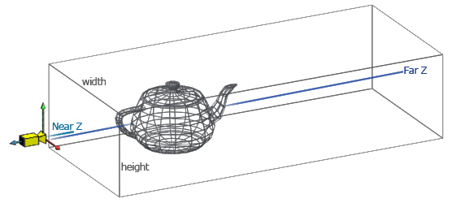
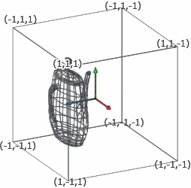
Vertex transformations pipeline
The NDC coordinates, are the coordinates of an object after projection and perspective division.
We use the projection matrix to transform from view coordinates to clip coordinates.
We then perform the perspective division (x/w, y/w, z/w) to obtain the NDCs.
Orthographic or parallel projection
projection and perspective division

Slide 11
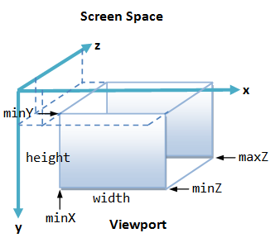
Vertex transformations pipeline
The window coordinates, are the coordinates of an object after its viewport transformation.
The viewport transformation is carried out by a fixed part of the pipeline. Controlled by these functions:
glViewport()
glDepthRange()

Slide 12
Reference
For reference, have a look at LearnOpenGL’s post on Coordinate Systems:
https://learnopengl.com/Getting-started/Coordinate-Systems

Slide 13

Transforms in the
GL Math library

Slide 14
GLM
GLM is a library with math types and functions
Much like MathGeoLib (I think you use it a lot in some other subjects)
It mimics glsl types and functions
It is likely that if you remember some function you used in GLSL during the ray tracing exercise, you will be able to use it in C++
Everything is in the namespace glsl:: (you can “open” the namespace if you like it so you do not need to type glm:: each time you want to use a function or type)

Slide 15

Camera transforms
The view matrix and the perspective projection matrices are created with the lookAt and perspective functions respectively
NOTE: You also have the ortho function to compute orthographic projections

Slide 16
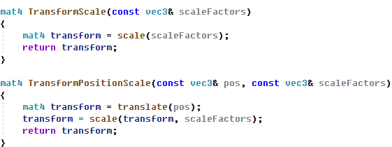
Entity transforms
Entity world transforms can be composed using translations, rotations, and scalings.
NOTE: If some time you need to change the direction of the coordinate transforms, use the inverse() function, which gives you the inverse matrix.

Slide 17
Transformation matrices
(slides for reference)

Slide 18
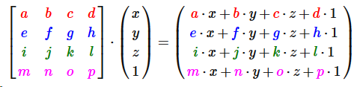
Homogeneous coordinates
To simplify calculations, in OpenGL we use homogeneous coordinates.
4 x 4 matrices
4 component points and vectors
Points: (x, y, z, 1)
Vectors: (x, y, z, 0)

Slide 19
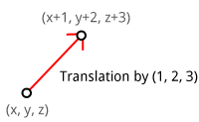
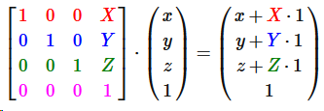
Translation matrix
Notice how it can only affect to points
vectors, whose 4th component is 0, are not affected by translations

Slide 20
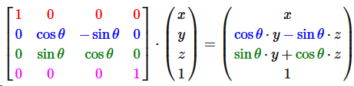
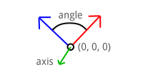
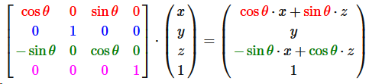
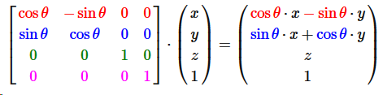
Rotation matrices
They affect to both points and vectors.

Slide 21
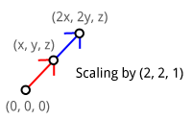
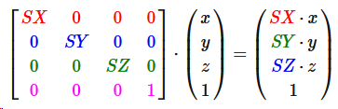
Scale matrix
They affect to both points and vectors.

Slide 22
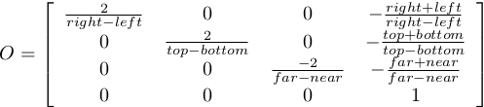
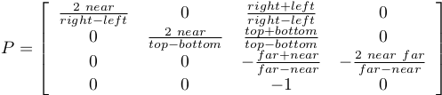

Projection matrices
Orthographic or parallel projection
Perspective projection
With left, right, bottom, top, near, and far
Perspective projection
With fovy, aspect, near, and far

